Slide 1







The conference is partly financed by the European Union

Slide 2




Administrative Data Quality Challenges through the Lens of e-Invoice
António Portugal, Bruno Lima,
João Poças, Paula Cruz,
Salvador Gil, Sofia Rodrigues
The conference is partly financed by the European Union

Slide 3




Topics
Context
Data Quality: Challenges and Methodology
Collaborative efforts
Application to other cases
Conclusions
The conference is partly financed by the European Union

Slide 4
1. Context
The conference is partly financed by the European Union
The use of administrative data has been a constant over the years at Statistics Portugal (INE), aiming a significant impact on reducing the statistical burden
2020 brought three new features to Statistics Portugal's production:
  The negative impact of the COVID-19 on the response rates to business surveys
  Receiving a huge amount of data from the electronic invoicing system (tax authority)
  The creation of a new unit dedicated to the collection, analysis and quality treatment of administrative data
  Management support for training in new skills (data science) tools and techniques, for all organisational units

Slide 5
1. Context
The conference is partly financed by the European Union
INE receives monthly, from the Tax Authority, about 100 M records (x 3 months, since January 2024) regarding taxable amounts aggregated by issuer and buyers
These amounts result from invoices issued by legal entities (or natural) persons based in Portugal

Slide 6
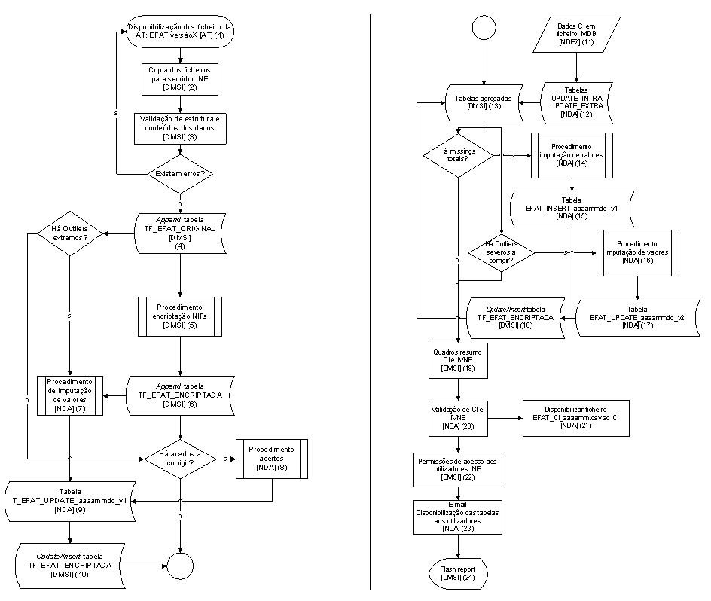
2. Data Quality: Challenges and Methodology
Validation of data structure
Encryption of personal identifiers
Normalisation of attributes (country codes)
Adding attributes from other sources
Imputation of outliers and missing values
Correction of negatives values
Comparison with other datasets
24h to treat each reference month

Slide 7
2. Data Quality: Challenges and Methodology
Missing values
  Total missing: in one period, an issuer does not have any value
  Partial missing: in one period, an issuer has, simultaneously, less invoiced value and less “buyers”
  When missing values are identified, for most relevant issuers, we need to estimate
  Using the time series of the taxable values (VT) of each issuer, we make forecasts and provide imputed data to the users

Slide 8
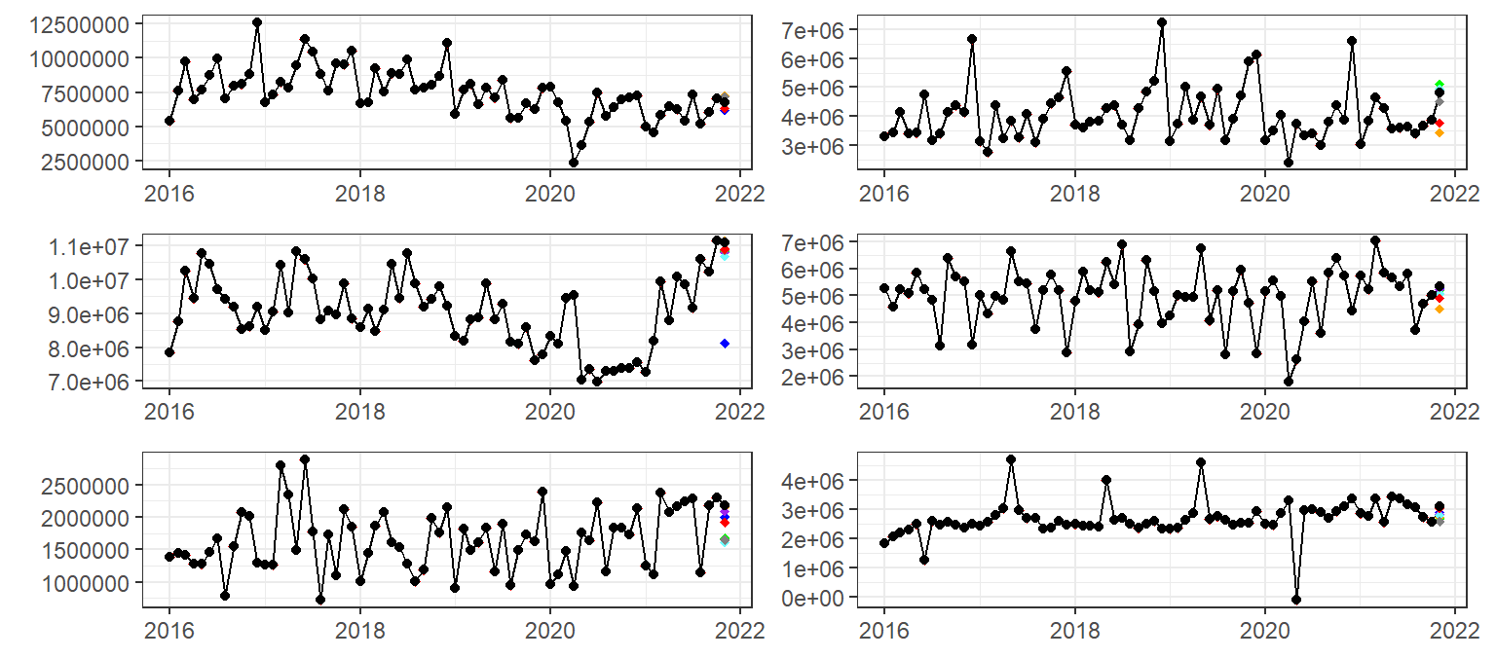
2. Data Quality: Challenges and Methodology
E-invoice time series are very heterogeneous (difficult to fit a unique model)

Slide 9
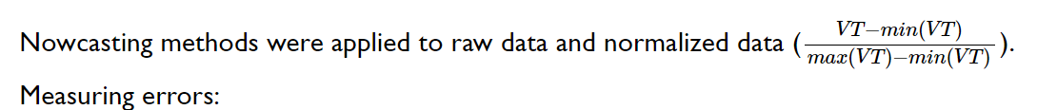
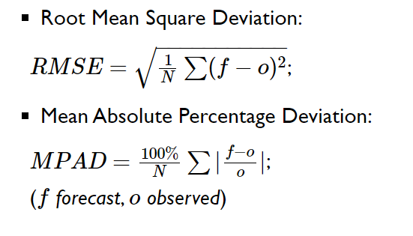
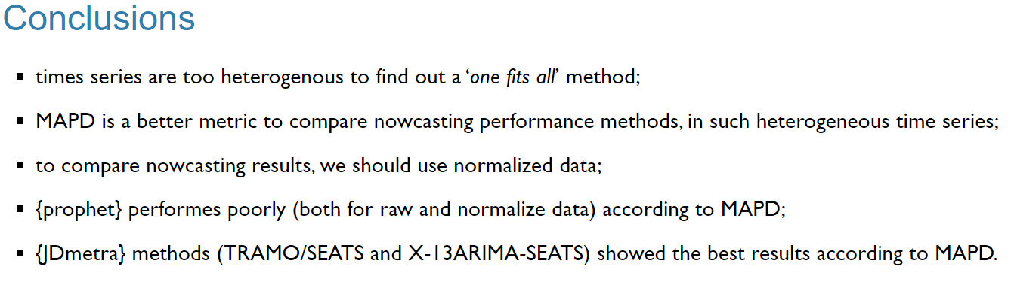
2. Data Quality: Challenges and Methodology
Evaluate, continuously, different nowcasting algorithms:
  Auto ARIMA, TRAMO/SEATS, X-13 ARIMA-SEATS, Kalman Smoothing, Prophet
Apply those to each time series and comparing the estimation with the data received on a second version:
  Root Mean Square Deviation (RMSD)
  Mean Absolute Percentage Deviation (MAPD) (better metric heterogeneous T.S.)

Slide 10
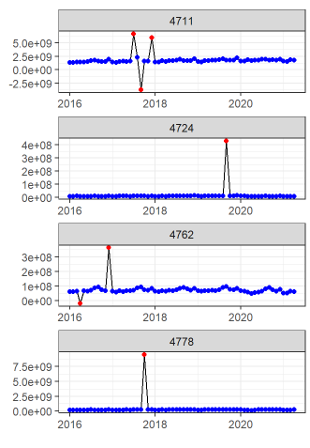
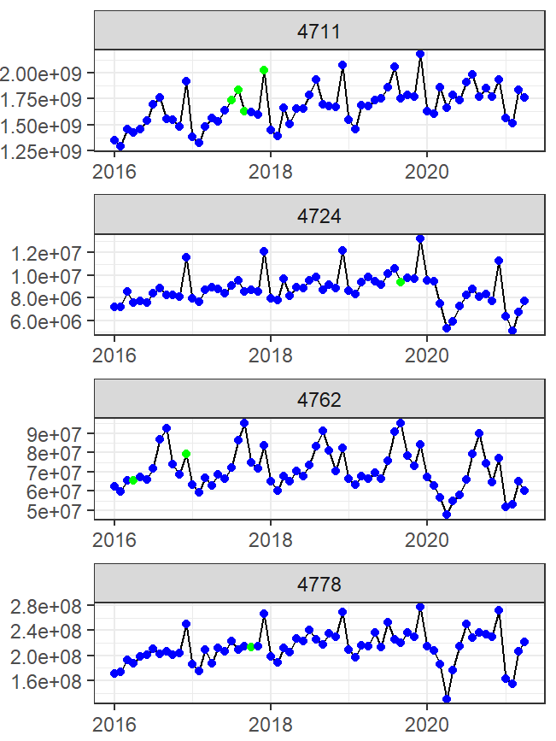
2. Data Quality: Challenges and Methodology
Original data Imputed data

Slide 11
3. Collaborative efforts
Using administrative data for Statistical purposes should not be seen as a one-way communication process
In order to promote the use of data, it is important to know the needs and expectations of its users in the statistical production process
To this end, a close dialogue was/is promoted with data users in order to consider and harmonize their needs in the adoption of a data treatment that is accepted by all
To make it easier to analyse the data, a monthly ‘Flash Report’ is produced and delivered in ‘R Flexdashboard’ (soon using a ‘shiny App’)

Slide 12
4. Application to other cases
The methodologies and insights gained from managing e-invoice data can be effectively applied to other administrative data sources
  Adapting standardized procedures (data loading, normalisation, validation)
  Customizing anomaly detection (and imputation) algorithms
  Improving data integrity and consistency (cross-dataset comparisons and temporal consistency checks)
  Promotion of collaboration and engagement of other units

Slide 13
4. Application to other cases
Data sets being prepared for the application of these methodologies:
  Monthly pay statements (enhance the quality and reliability of employment and earnings data)
  International Trade, with identification of anomalies (speeding up correction work in data collection)
  Personal income tax data (IRS)
  Real estate transaction tax (IMT) and Property tax (IMI)
  …
Contributing to increase/improve the quality of the National Data Infrastructure

Slide 14
5. Conclusions
Strong collaboration between different Units of the statistical production process plays a very important role
Investment in acquiring new skills (Data Science), tools and techniques, in order to overcome the difficulties in processing a massive set of data

Slide 15
5. Conclusions
The e-invoice can be seen as a a booster (PoC) for the treatment and use of administrative data for statistical purposes:
  Applies a set of procedures already in use in traditional sources (surveys)
  Was recognized as the right way to apply for other data sources
  Contributes to the construction and fulfilment of the objectives of the National Data Infrastructure
The work is not finished and is still evolving

Slide 16
Administrative Data Quality Challenges through the Lens of e-Invoice
António Portugal, Bruno Lima,
João Poças, Paula Cruz,
Salvador Gil, Sofia Rodrigues
Obrigado
Thank you
joao.pocas@ine.pt
The conference is partly financed by the European Union

Slide 17

The conference is partly financed by the European Union

